Slide 1

Experiential Learning Project Assessment-I on
“ Random Password Generator in Python”
under the course
Python Programming Language (N-PCCCM304P)
Presented By
Under the Guidance of
Mrs. Mayuri Getme
Bhumika Dandare
- CM25012
Session:2026-27 (ODD )
Department of CSE(AI&ML)
S. B. JAIN INSTITUTE OF TECHNOLOGY MANAGEMENT AND
RESEARCH,NAGPUR
An Autonomous Institute, Affiliated to RTMNU, Nagpur
)

Slide 2

Content
Problem statement
Objectives
Algorithm
Flowchart/pseudocode
Understanding of Python logic
GitHub account, repository creation, uploading code, meaningful commits, collaboration, individual contribution
S. B. Jain Institute of Technology Management and research

Slide 3

Problem Statement
We use passwords for many online accounts.
Simple and repeated passwords are easier to guess.
Creating a different strong password for every account can be difficult.
Users need passwords with a combination of different characters.
Therefore, we developed a Python program that automatically generates customizable passwords.
The user can decide the length and character types used in the password.
Character Types
Uppercase: A–Z
Lowercase: a–z
Numbers: 0–9
Special Characters: @, #, $, %, etc.

Slide 4

Objectives
To develop a practical application using Python.
To generate passwords automatically using random character selection.
To allow users to customize password length.
To provide different character-selection options.
To understand Python concepts through a real-world problem.
To apply conditions, loops, functions and modules.
To learn secure random generation using the secrets module.
To gain practical experience with GitHub and version control.

Slide 5

Algorithm
Step 1: Start the program.
Step 2: Ask the user to enter the required password length.
Step 3: Ask the user whether to include: Uppercase letters Lowercase letters Numbers Special symbols
Step 4: Create an empty character set.
Step 5: Add the selected character types to the character set.
Step 6: Check whether the character set is empty. If Yes, display "Please select at least one character type" and stop. If No, continue.
Step 7: Randomly select characters from the character set until the required password length is reached.
Step 8: Display the generated password.
Step 9: End the program.

Slide 6

Flowchart
start
Enter Password Length
Select Character Types
Uppercase
Lowercase
Numbers
Symbol

Slide 7
A
Create Character Set from selected types
Is the character set empty
Display Error:
Please select at least one charecter
Generate random
Character until required length

Slide 8
B
End
Display the generate password
End

Slide 9

Understanding Of Python Logic
.Variables: Used to store information such as password length and the generated password.
Input: The input() function is used to take the required password length and choices from the user.
If Condition: Used to check which types of characters the user wants to include.
Loop: Used to repeatedly select characters until the required password length is reached.
Function: Helps organize the password-generation process into a reusable block of code.
String: Used to handle letters, numbers, and special characters.
Modules: The string and secrets modules provide useful features for password generation.
Random Selection: secrets.choice() selects a character randomly from the available character set.

Slide 10

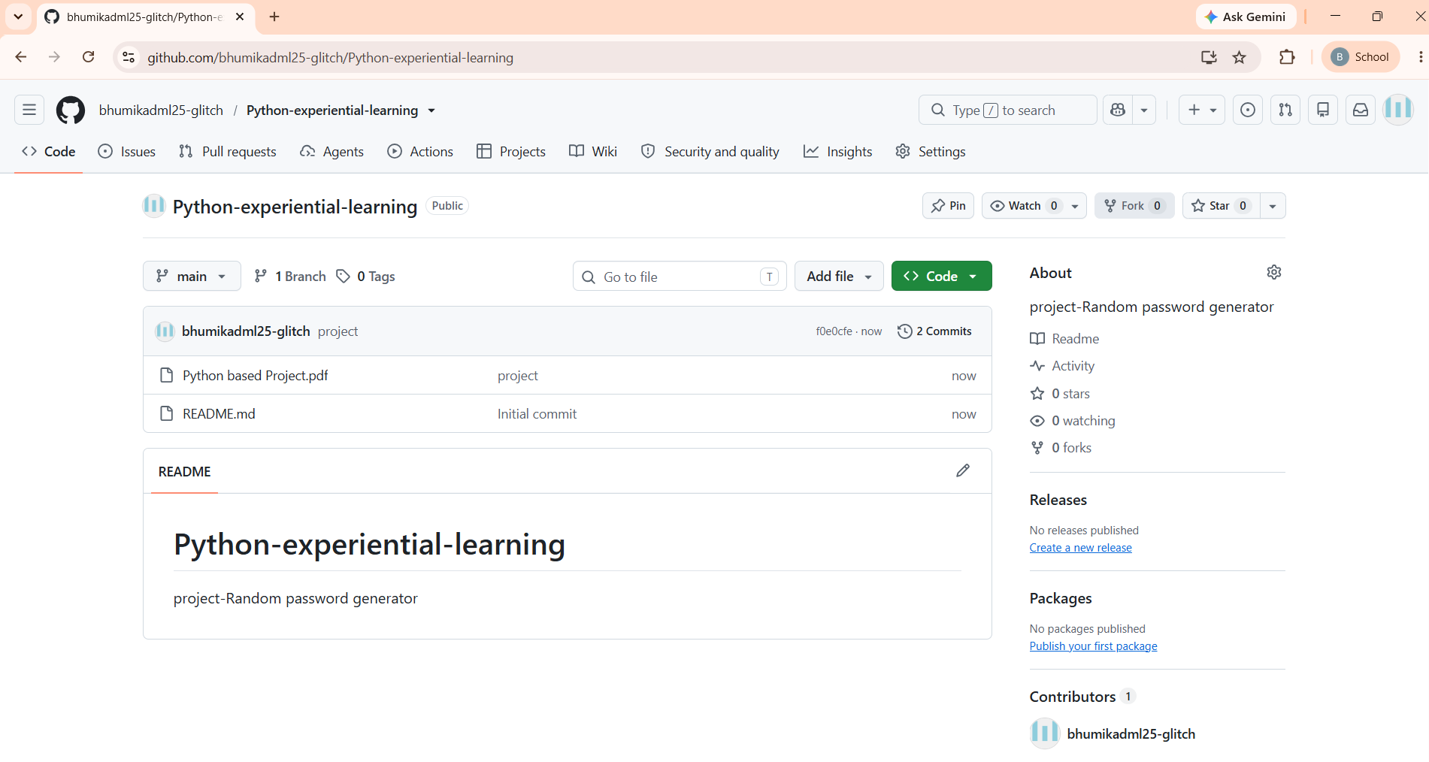
Git GitHub account, repository creation, uploading code, meaningful commits, collaboration, individual contribution
A repository is an online storage space where the project’s Python code, files, documentation, and version history are maintained. A commit records project changes with a clear message, such as “Added password generation logic”, making the project history easy to understand.

Slide 11
Phase – 2
S. B. Jain Institute of Technology Management and research

Slide 12

Basic password generation does not provide complete customization and strength checking.
Problem Statement
Users need flexibility to select password length and character types.
Generating passwords of different strength levels requires additional options.
Users need a simple way to check password strength.
Generating multiple passwords individually can be time-consuming.
Users may need an option to save generated passwords for reference.
Therefore, the project is enhanced with strength-based generation, password checking, multiple password generation, input validation, and file saving.

Slide 13
Objectives
To develop a functional Random Password Generator using Python.
To generate secure passwords using the secrets module.
To provide customizable password length and character selection.
To implement Easy, Moderate, and Strong password presets.
To check password strength using different criteria.
To generate multiple passwords in a single execution.
To save generated passwords in a text file.
To apply Object-Oriented Programming and exception handling.
To gain practical experience with GitHub and version control.

Slide 14
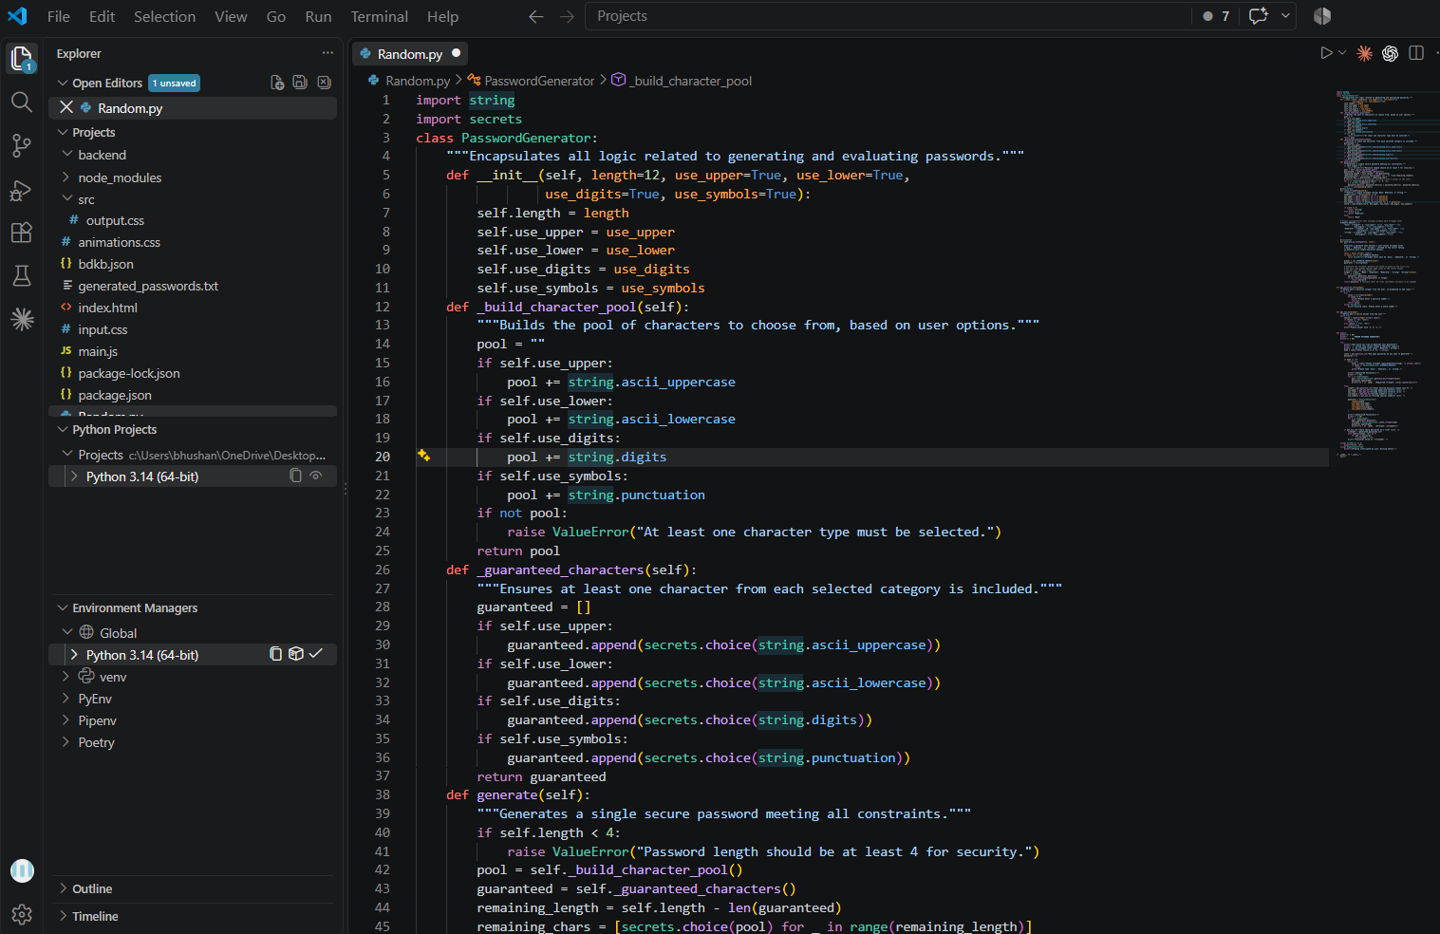
Python Code-Password Generation

Slide 15

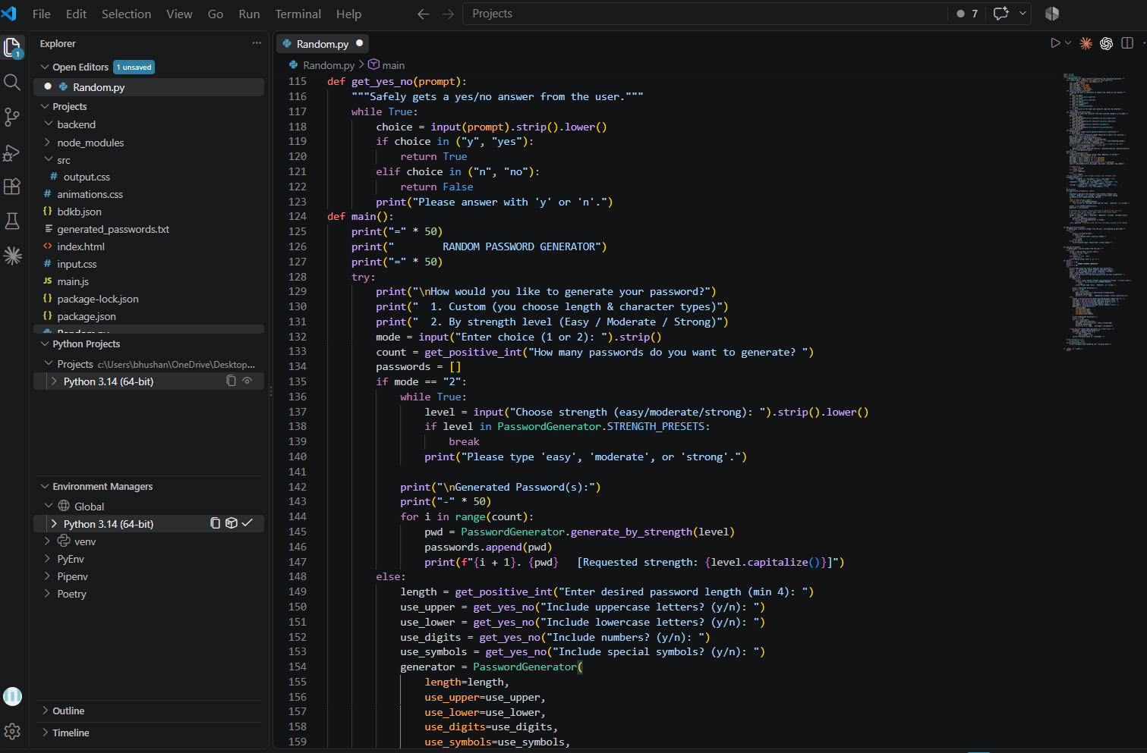
Python Code-Strength Checker

Slide 16

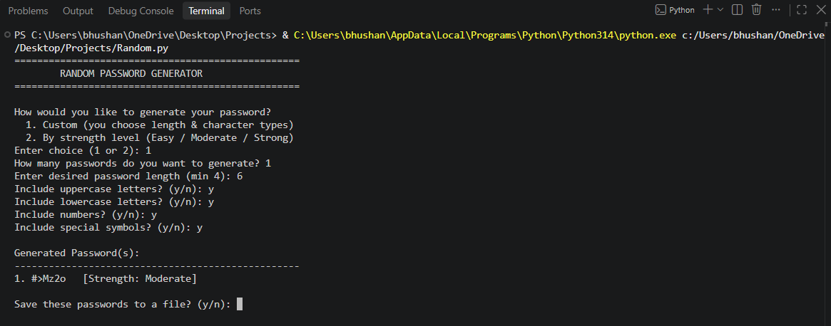
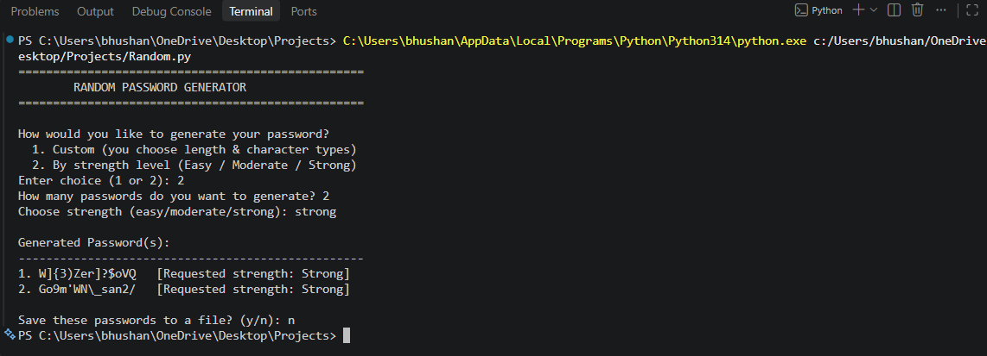
Output

Slide 17

Understanding Of Python Logic
Class and Objects: The PasswordGenerator class organizes the password generation functions.
Character Pool: The string module provides lowercase letters, uppercase letters, digits, and symbols.
Random Selection: The secrets module selects characters securely for generating passwords.
Conditional Statements: if-else statements check user choices and selected character categories.
Loops: Loops generate passwords, collect required characters, and repeat the process when needed.
Password Strength: The check_strength() method checks password length and character types to classify its strength.
Functions and Methods: Separate methods make the program modular, organized, and easier to understand.
File Handling: The program can optionally save generated passwords in generated_passwords.txt.

Slide 18
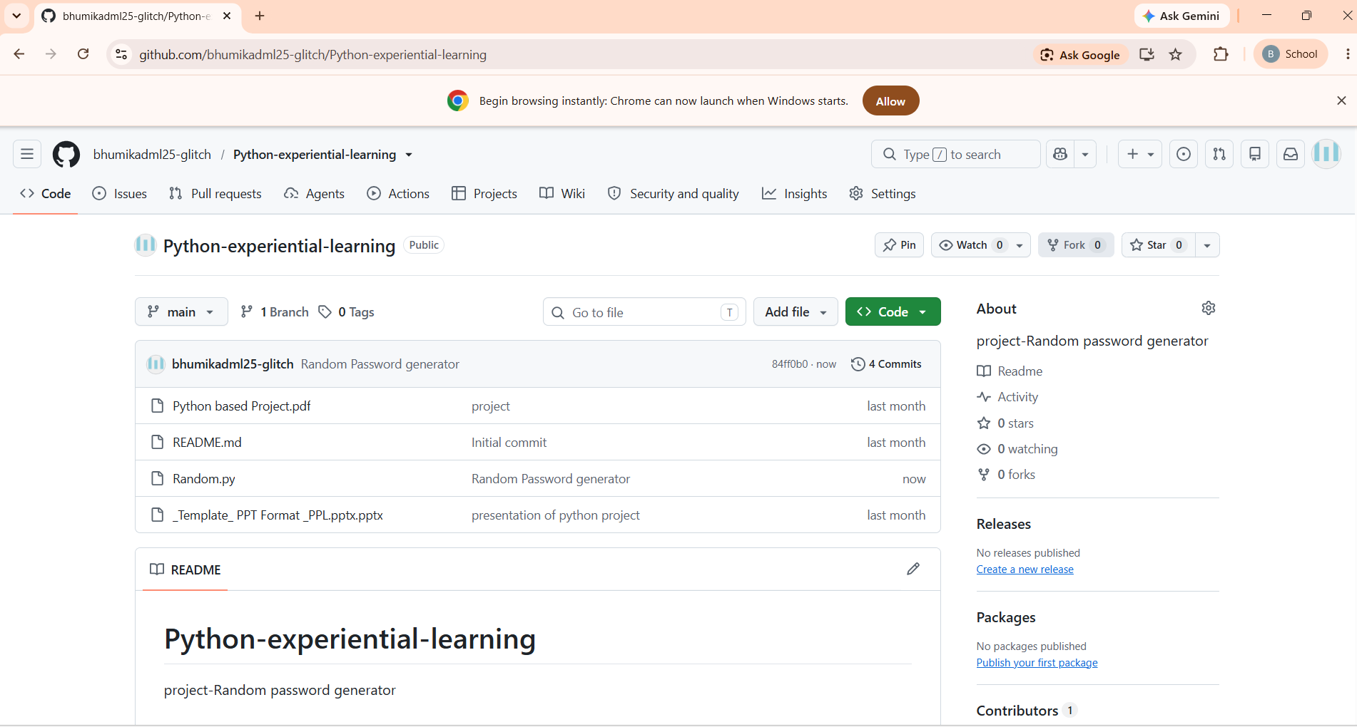
GitHub account, repository creation, uploading code, meaningful commits, collaboration, individual contribution

Slide 19
Thank You

